Slide 1
Object Localization and Detection Algorithms

Slide 2
Before Deep Learning
Hand-crafted features (mostly class-agnostic) given to simple (usually linear classifiers)
Very difficult to scale and generalize to today’s problems. Also, not too accurate
Scale Invariant Feature Transform (SIFT, circa 2000)
Viola-Jones Face Detector (2001 - www.ipol.im/pub/art/2014/104/article.pdf)
Histogram of Oriented Features (HOG, 2005)

Slide 3
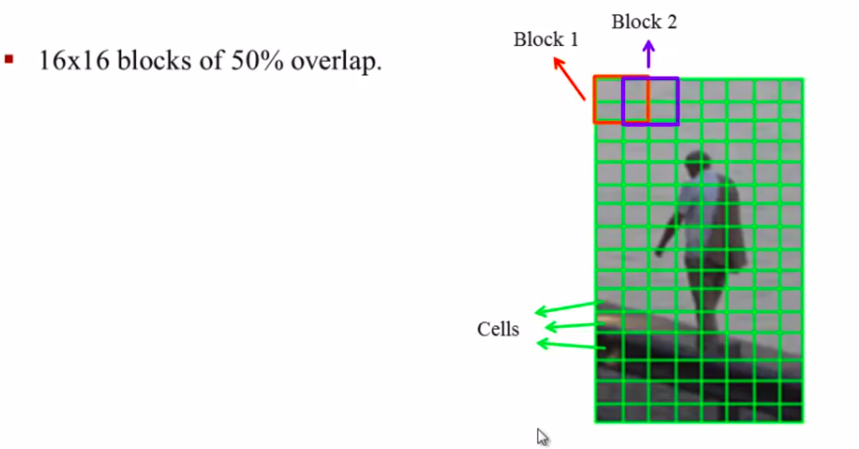
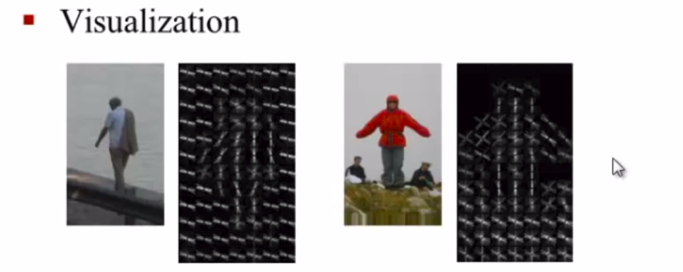
Before Deep Learning - The HOG Algorithm
Divides the image into (say, 16x16) cells
Calculates the “gradient” in each cell (direction of light -> dark)
Use Tri-linear interpolation to calculate the overall gradient
Image credits: https://www.youtube.com/watch?v=0Zib1YEE4LU&t=594s

Slide 4
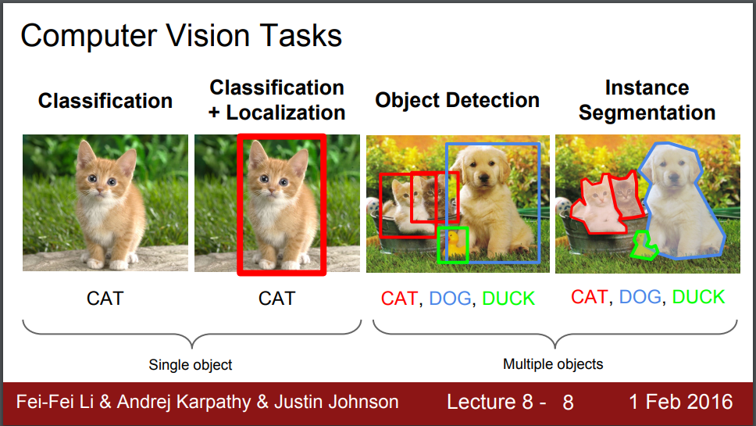
Modern Ideas (Post 2012)

Slide 5
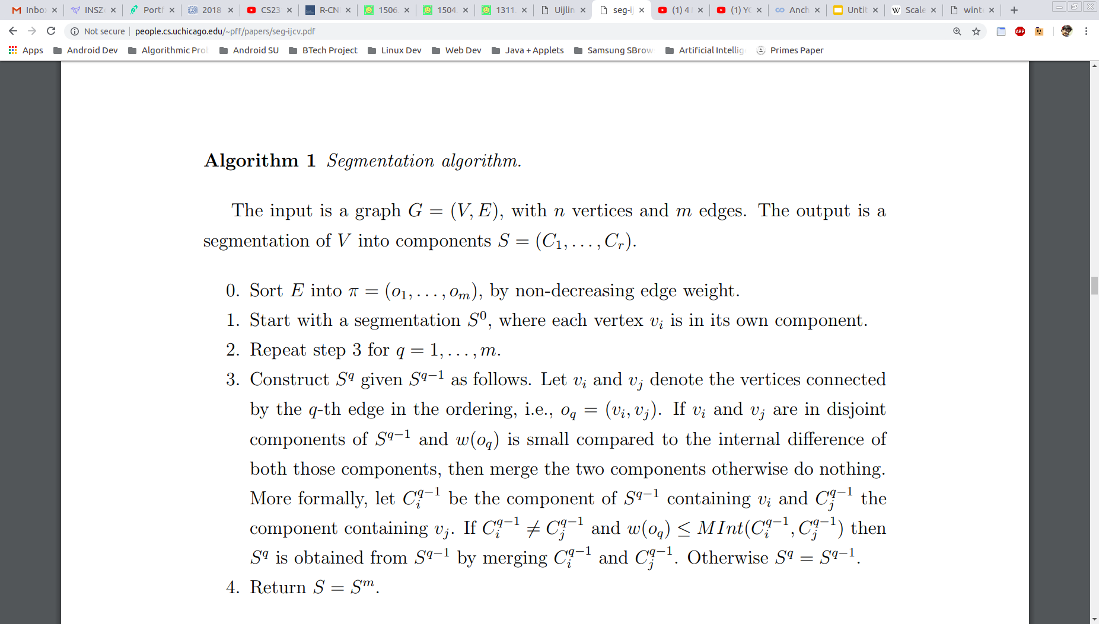
Graph Based Image Segmentation
Imagine an image as a weighted undirected graph G (V, E)
Vertices may be the pixels and the edges between neighboring pixels are weighted by a dissimilarity score (e.g., the difference in intensity, color, motion, location or some other local attribute)
Kruskal-like algorithm running in O(n log n) time for n pixels
Paper - http://people.cs.uchicago.edu/~pff/papers/seg-ijcv.pdf

Slide 6
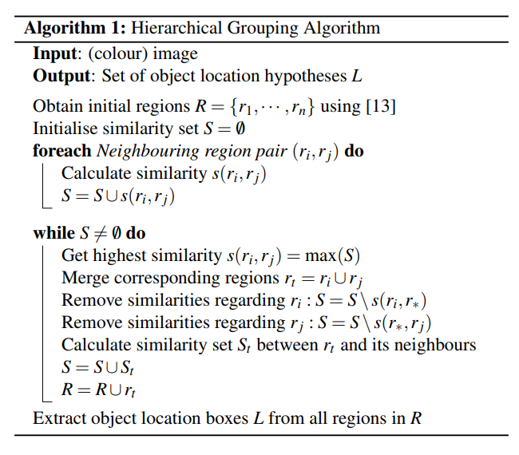
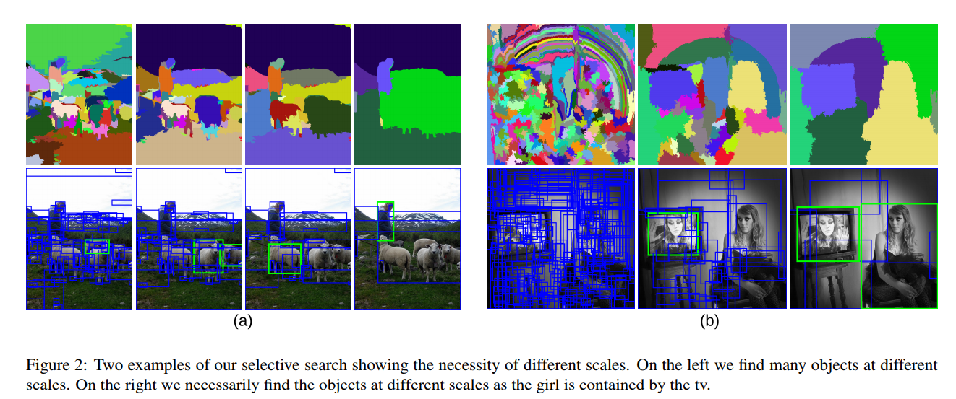
The Selective Search Algorithm
Uses the previous algorithm and groups together closely related regions in a bottom-up fashion
Paper - https://ivi.fnwi.uva.nl/isis/publications/2013/UijlingsIJCV2013/UijlingsIJCV2013.pdf

Slide 7
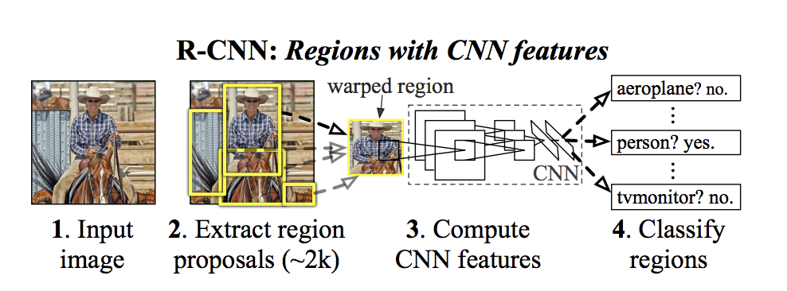
R-CNN
Uses Selective Search to extract ~2000 features
Each of these features are “warped” (basically resized and cropped) into fixed input dimensions
Each of the features are passed into (pretrained) AlexNet, yielding a 4096 vector for each
Each of these 4096 vectors are passed into a one-vs-all SVM (trained separately for each class)
Final step includes a bounding box regularizer (for fine-tuning the boxes)
Paper - https://arxiv.org/abs/1311.2524

Slide 8
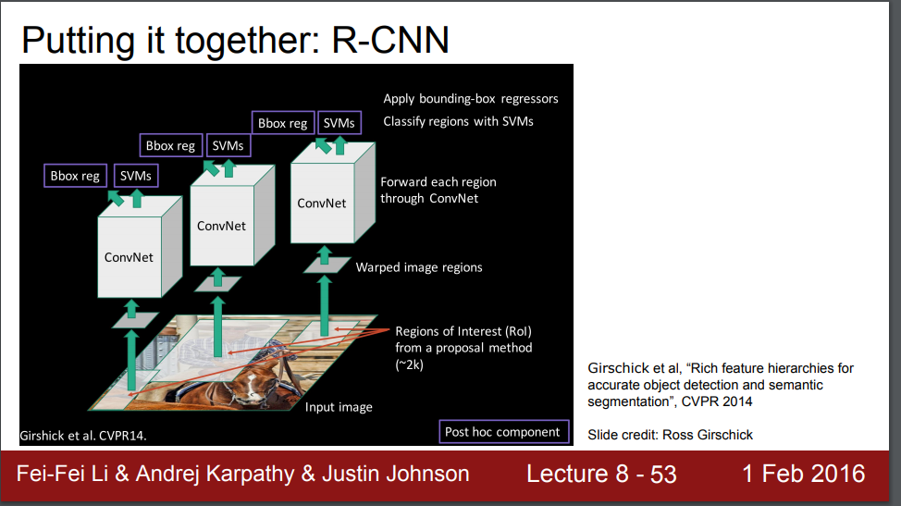
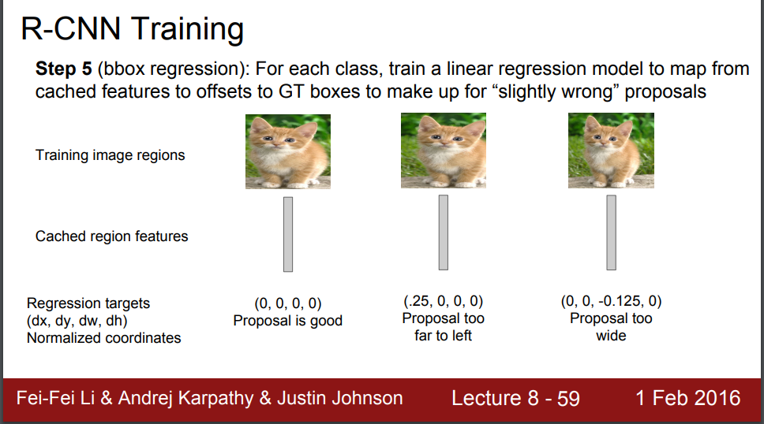
R-CNN (Addition of Bbox Regressor)

Slide 9
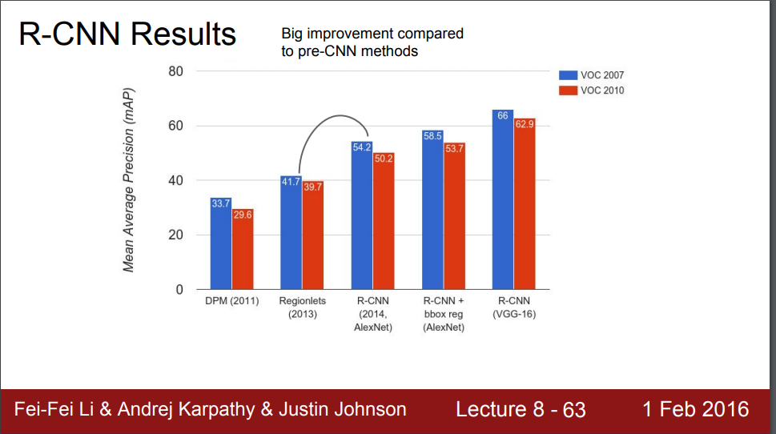
R-CNN Results

Slide 10
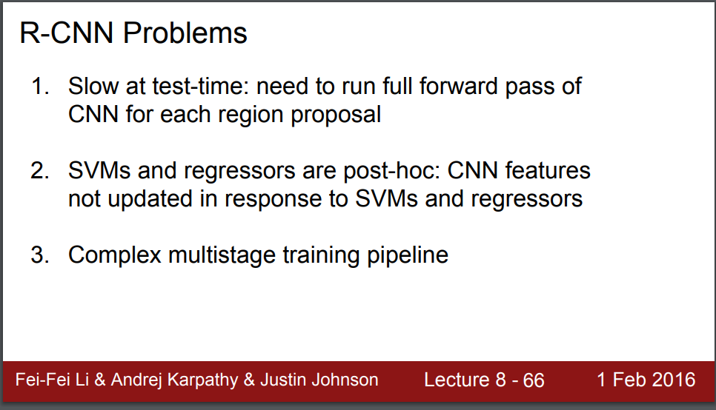
R-CNN Drawbacks

Slide 11
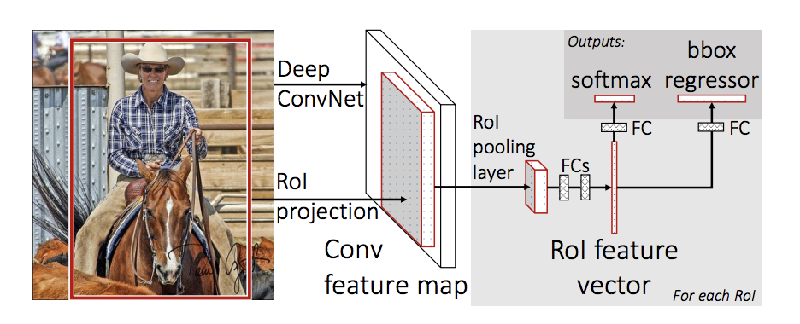
Fast R-CNN
Instead of feeding ~2000 region proposals, feed the entire image into a CNN which outputs a feature map (CNN as the region-extractor)
Pass these features into a ROI pool (since FC layer expects low-quality features)
Final loss is a softmax+bbox regressor loss (smooth L1)
Region proposals still come from an external source (like selective search) - Thats the bottleneck!
Paper - https://arxiv.org/abs/1311.2524

Slide 12
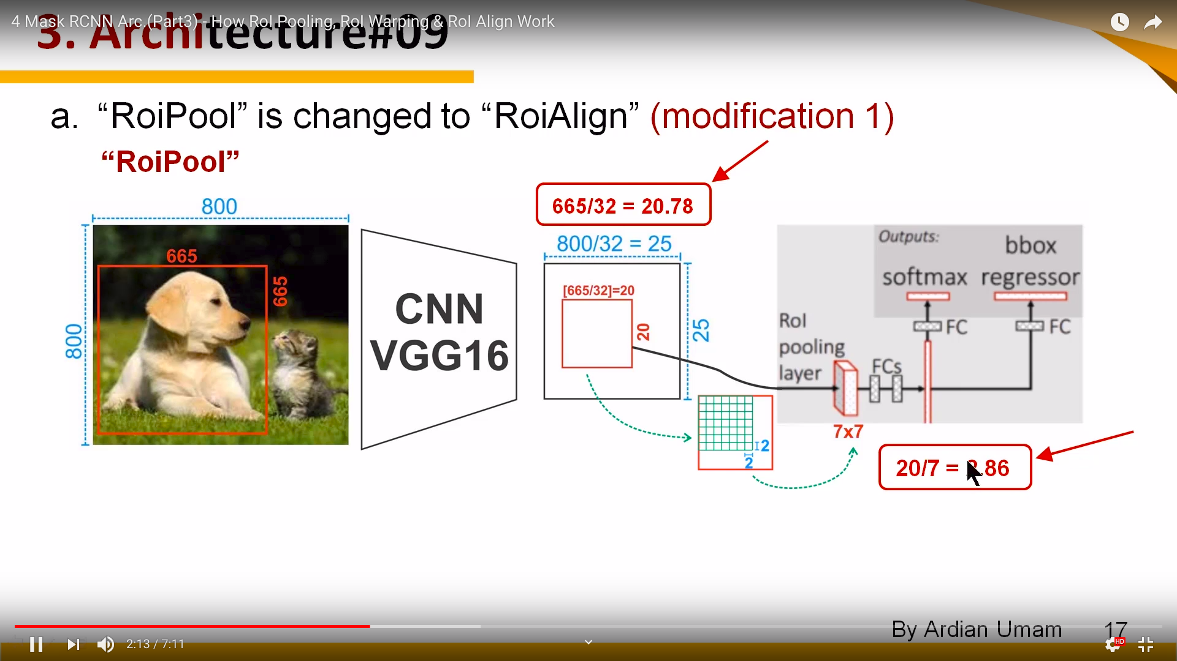
Fast R-CNN - The ROI Pool
Courtesy: https://www.youtube.com/watch?v=XGi-Mz3do2s

Slide 13
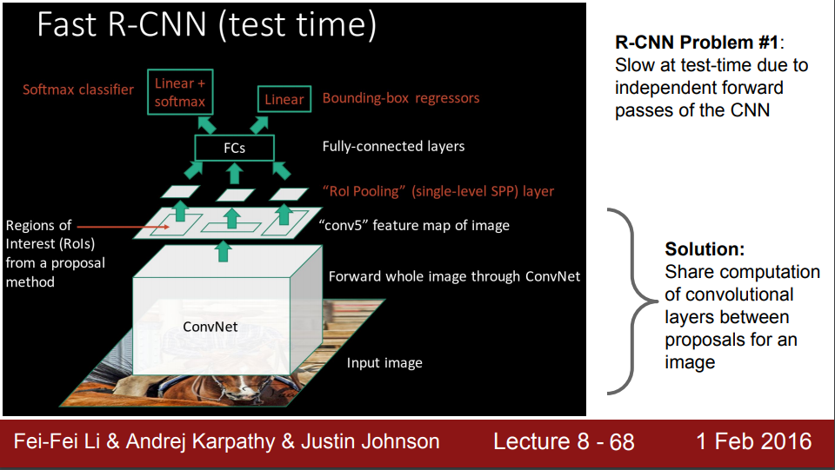

Slide 14
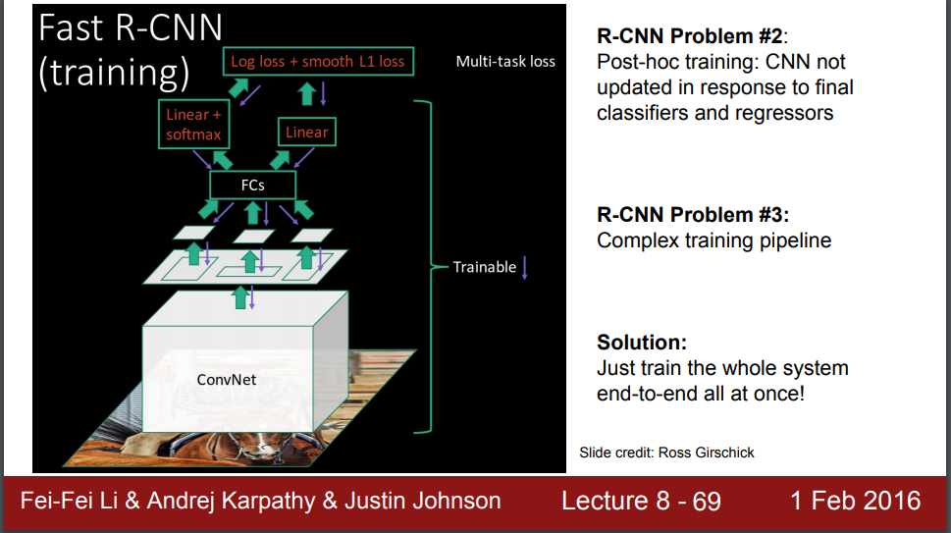

Slide 15
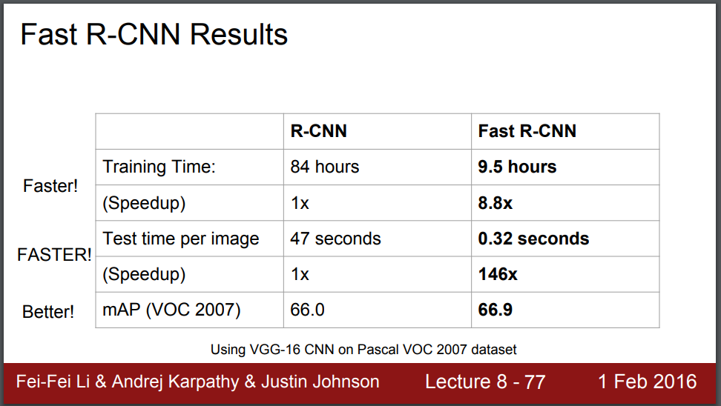

Slide 16
Faster R-CNN
Let the CNN do region proposals too!
Insert a Region Proposal Network (RPN) after the last convolutional layer
RPN is trained to produce region proposals directly
But how? Using something called “anchors” or “anchor boxes”

Slide 17
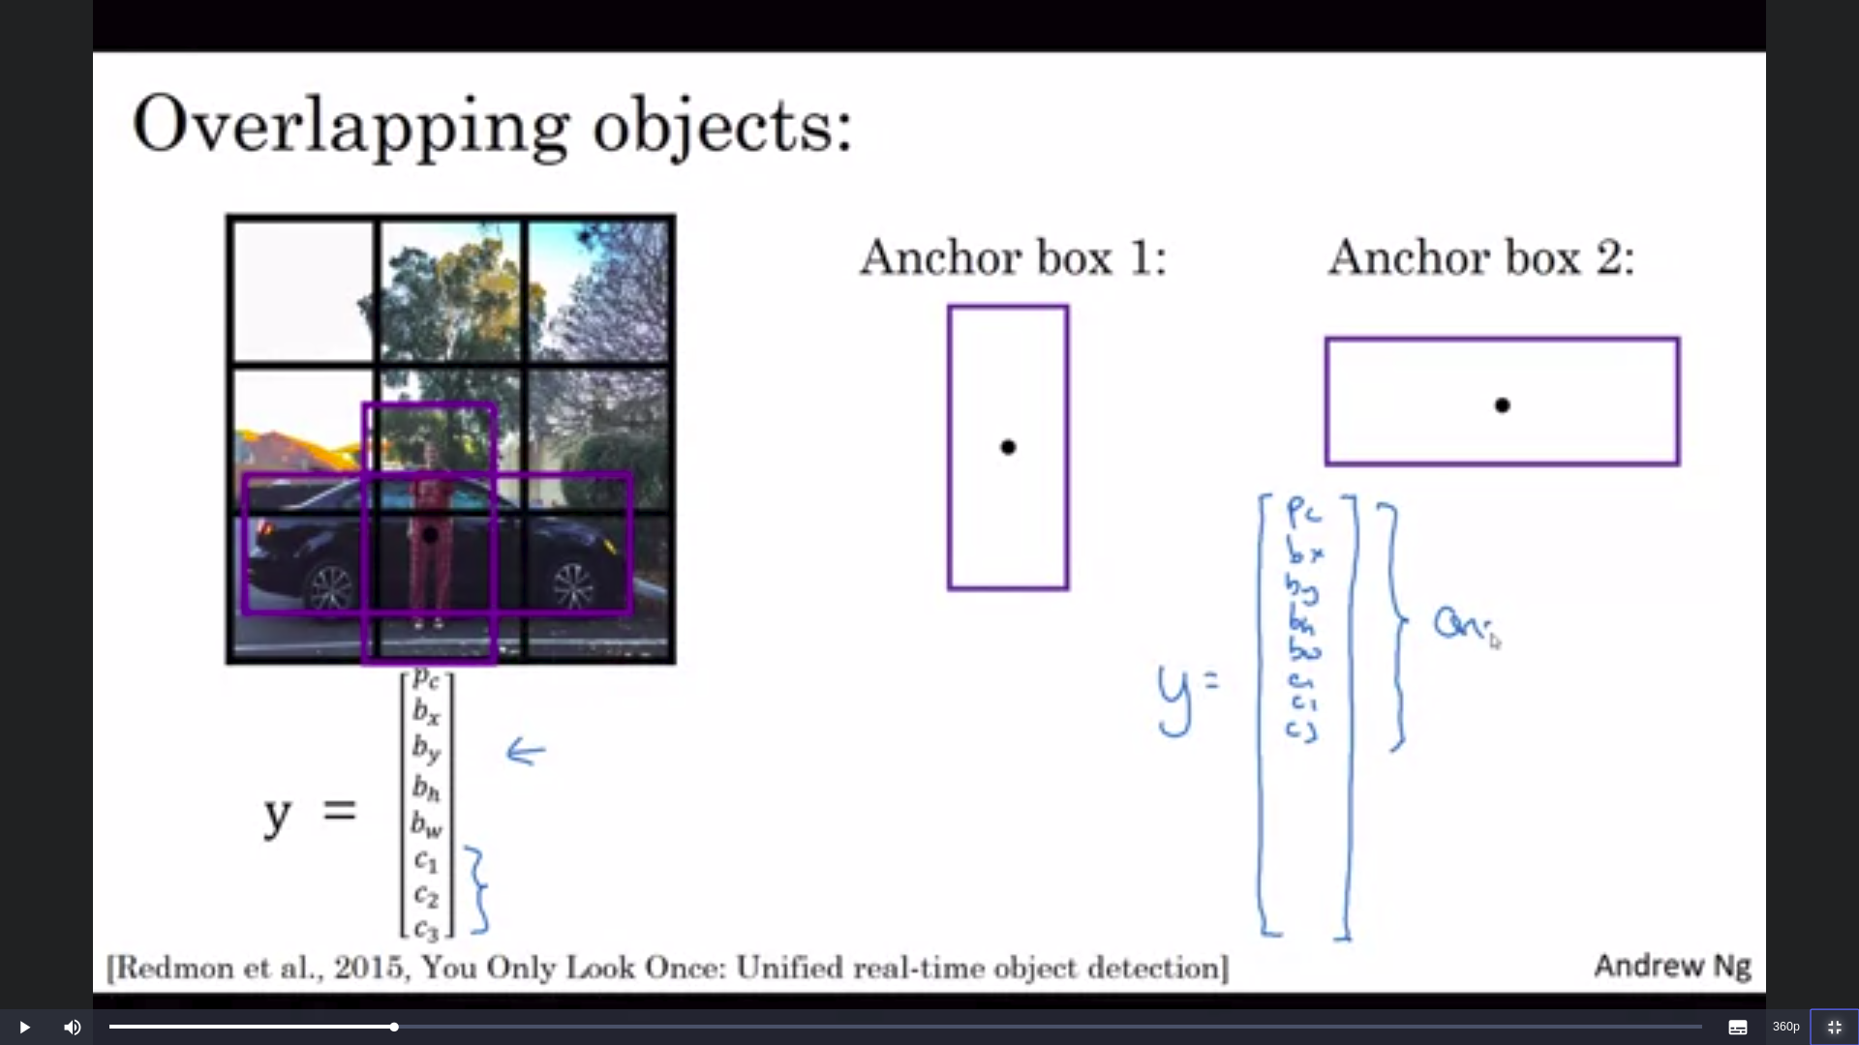
Anchor Boxes
Think of them as fixed outlines
The RPN regressor head predicts x, y, h, w, p and N class scores for each of the anchor boxes
Objects are then assigned to anchor boxes with highest IOU with their shape
Faster R-CNN uses 3 scales and 3 shapes (aspect ratios), thus 9 anchor boxes

Slide 18
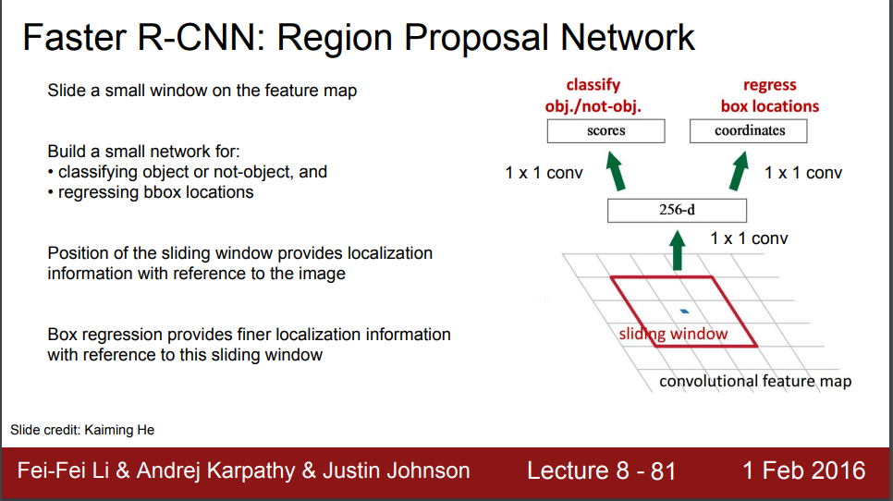

Slide 19
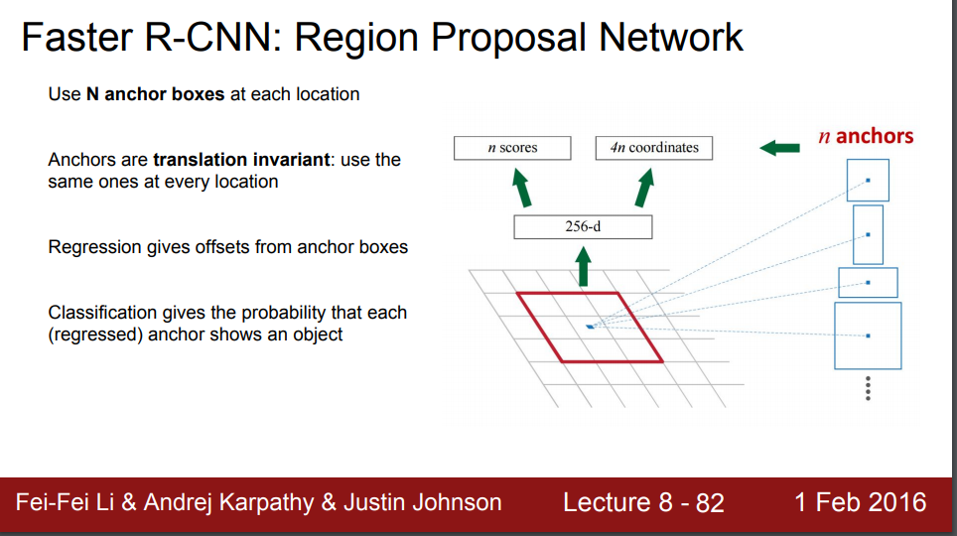

Slide 20
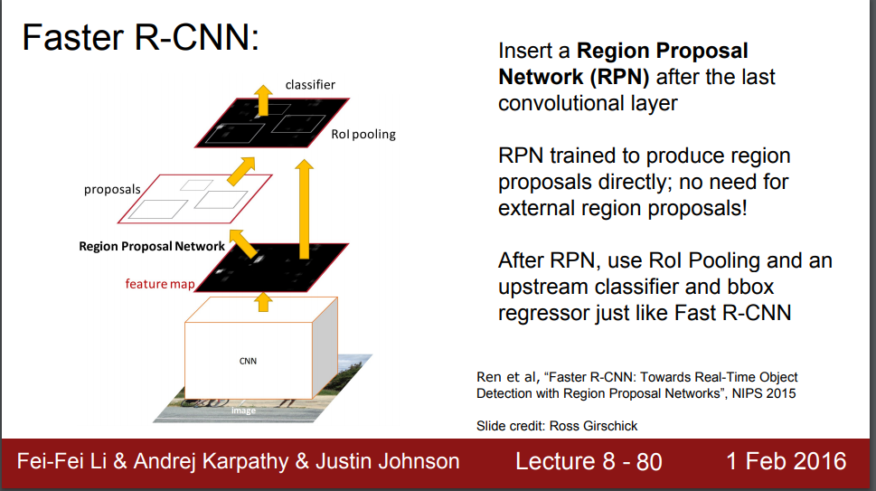

Slide 21
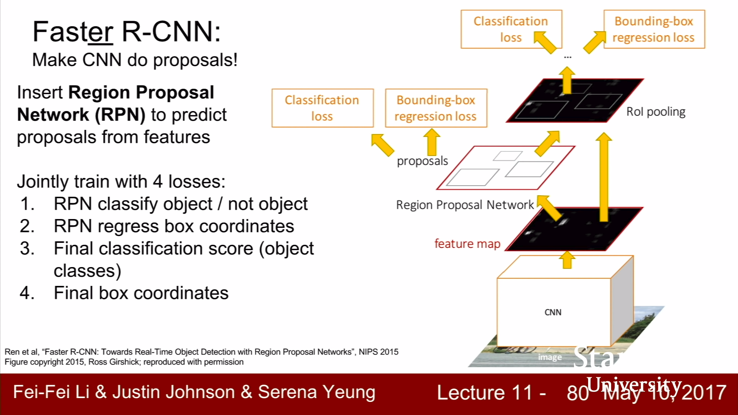

Slide 22
The YOLO Classifier (You Only Look Once)
Divides the image into a grid 13x13 cells
Each of these cells predicts 5 bounding boxes, along with a confidence score
The confidence score if for the bounding box, not for the class
Thus, the cells also have to output class probabilities
13x13 cells, each predicting 5 bboxes => 845 bboxes!
Add a threshold limit to the confidence of these bboxes to reduce number drastically (threshold of 30% works too)
YOLO v2 consists of alternating conv and maxpooling layers only!

Slide 23
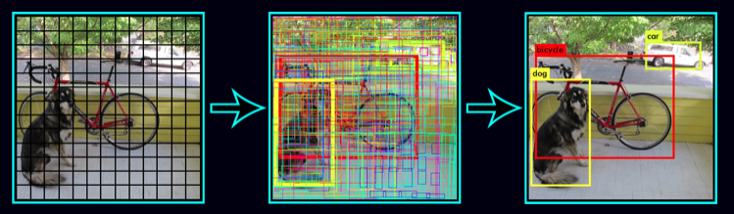
YOLO in Practice

